Slide 1

Cyber Minutes
“New Year, New Threats"
01-10-2024 | Jonathan Montoya

Slide 2

Terrapin Attack
CVE-2023-48795, CVSS score: 5.9 CVSS:3.1/AV:N/AC:H/PR:N/UI:N/S:U/C:N/I:H/A:N
Nearly 11 million internet-exposed SSH servers are vulnerable to the Terrapin attack
Majority of the instances have been identified in the U.S. (3.3 million), followed by China (1.3 million), Germany (1 million), Russia (700,000), Singapore (390,000), and Japan (380,000) –Shadowserver Foundation
Flaw impacts SSH client and server implementations, such as OpenSSH, PuTTY, KiTTY, WinSCP, libssh, libssh2, etc.

Slide 3

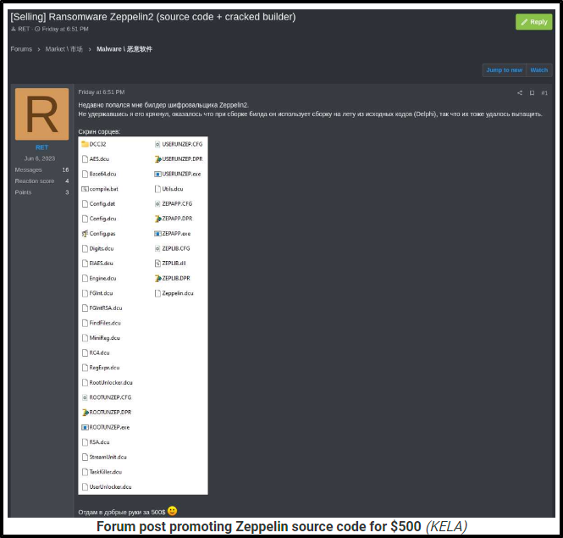
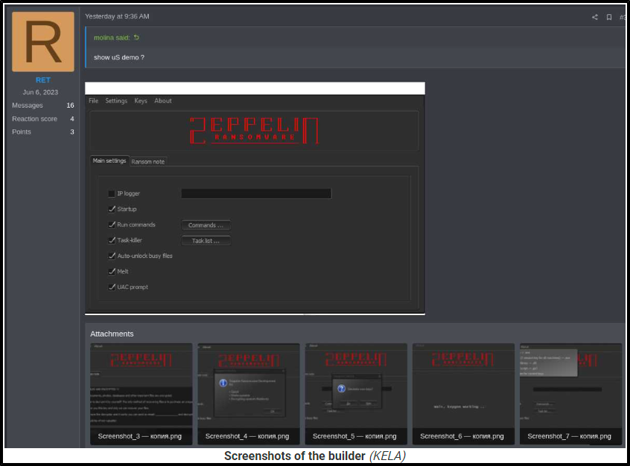
$500 Ransomware
The sale of the Zeppelin Ransomware builder source code and a cracked version for just $500 was announced on a crime forum
This allows groups to start a RaaS easily and lowers the skill gap tremendously
FBI issued warnings about Zeppelin Ransomware operators invoking new tactics of multi round encryption back in summer 2022
Zeppelin RaaS discontinued in late 2022 following multiply flaws being found in the malware, allowing a decrypter to be built
Seller has stated that these flaws are no longer present in the current version of the Ransomware

Slide 4
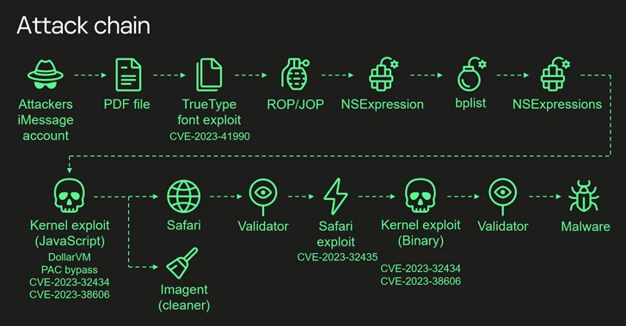
“Operation Triangulation”
This was campaign was discovered by cybersecurity firm Kaspersky at the beginning of 2023 after becoming a target of the attack
The exploitation involves 4 zero-day flaws combined to “obtain an unprecedented level of access and backdoor target devices running up to iOS 16.2”
This highly sophisticated hack has only been seen in malware like Pegasus spyware, which Apple released patches in Sept. 2023 to directly combat

Slide 5

Sources
https://thehackernews.com/2024/01/spectralblur-new-macos-backdoor-threat.html
https://www.bleepingcomputer.com/news/security/nearly-11-million-ssh-servers-vulnerable-to-new-terrapin-attacks/
https://www.bleepingcomputer.com/news/security/zeppelin-ransomware-source-code-sold-for-500-on-hacking-forum/
https://www.darkreading.com/cyberattacks-data-breaches/23andme-negligent-users-at-fault-breach-7m-records
https://www.darkreading.com/cloud-security/attackers-abuse-google-oauth-endpoint-hijack-user-sessions
https://thehackernews.com/2023/12/most-sophisticated-iphone-hack-ever.html

